Slide 1
IBM University Engagement Project Submission
PROJECT TITLE: Audio Signal Processing Assistant Agent
“Exploring the Power of Agentic AI with IBM Granite and LangFlow”

Slide 2
Problem Statement -
Problem Statement: Audio Signal Processing Assistant Agent
The Challenge
Audio signal processing is a fundamental area in electronics, communication systems, and digital signal processing. Students, hobbyists, and engineers often face difficulties in understanding concepts such as noise reduction, filtering, signal distortion, sampling, quantization, frequency analysis, and audio equipment troubleshooting.
Without an intelligent assistant, users spend significant time searching for solutions and understanding complex signal processing concepts.
The Objective
Build an AI-Powered Audio Signal Processing Assistant Agent using Langflow, IBM Watsonx.ai, and IBM Granite Models that provides intelligent guidance and troubleshooting support for audio signal processing applications.
The solution should:
Audio Knowledge Assistance - Provide explanations of DSP concepts, including filtering, sampling, quantization, FFT, frequency analysis, and signal reconstruction.
Audio Troubleshooting - Help users identify and resolve common audio problems such as humming noise, clipping, distortion, echo, feedback, and signal interference.
Intelligent Question Answering - Answer technical questions related to audio systems, amplifiers, microphones, speakers, and signal processing techniques.
AI-Powered Analysis - Generate context-aware recommendations and solutions based on user queries using IBM Granite foundation models.
Educational Support - Assist students in learning audio signal processing through simplified explanations and practical examples.

Slide 3
Technology | Purpose
Langflow | Workflow Design & Orchestration
IBM watsonx.ai | AI Platform
IBM Granite 8B | Large Language Model (LLM)
Prompt Engineering | AI Behavior Configuration
Agentic AI | Intelligent Assistance
NLP | Query Understanding & Response Generation
Technology Used

Slide 4
Proposed Solution
Proposed Solution: Audio Signal Processing Assistant Agent
The proposed solution is an AI-powered Audio Signal Processing Assistant Agent developed using LangFlow, IBM Watsonx.ai, and IBM Granite Models. The system is designed to assist students, engineers, researchers, and audio enthusiasts in understanding audio signal processing concepts and troubleshooting audio-related issues through natural language interaction.
The solution uses IBM Granite foundation models to analyze user queries and generate accurate, context-aware responses about audio systems and digital signal processing.
The system consists of four specialized AI functions:
Audio Knowledge Agent - Provides explanations of fundamental and advanced audio signal processing concepts, including filtering, sampling, quantization, the Fourier Transform, frequency analysis, and digital audio processing.
Troubleshooting Agent - Identifies common audio system issues such as humming noise, clipping, distortion, feedback, interference, and grounding problems, while suggesting practical solutions and corrective measures.
Signal Analysis Agent - Assists users in understanding signal characteristics, filter selection, frequency response, noise reduction techniques, and signal conditioning methods.
Learning Support Agent - Supports students and beginners by simplifying complex DSP concepts and providing educational explanations with real-world examples.
LangFlow is used to design and orchestrate the workflow, while IBM watsonx.ai provides secure access to IBM Granite models for natural language understanding and intelligent response generation.
Overall, the proposed solution acts as a virtual Audio Signal Processing Expert, enabling users to receive instant technical guidance, troubleshoot audio-related problems, and improve their understanding of audio engineering concepts through an interactive AI-powered interface.

Slide 5
Component | Function
Chat Input | Receives user queries
Prompt Template | Defines AI assistant behavior
IBM watsonx.ai | Connects to IBM AI services
IBM Granite Model | Generates intelligent responses
Chat Output | Displays results to users
Langflow component Used -

Slide 6
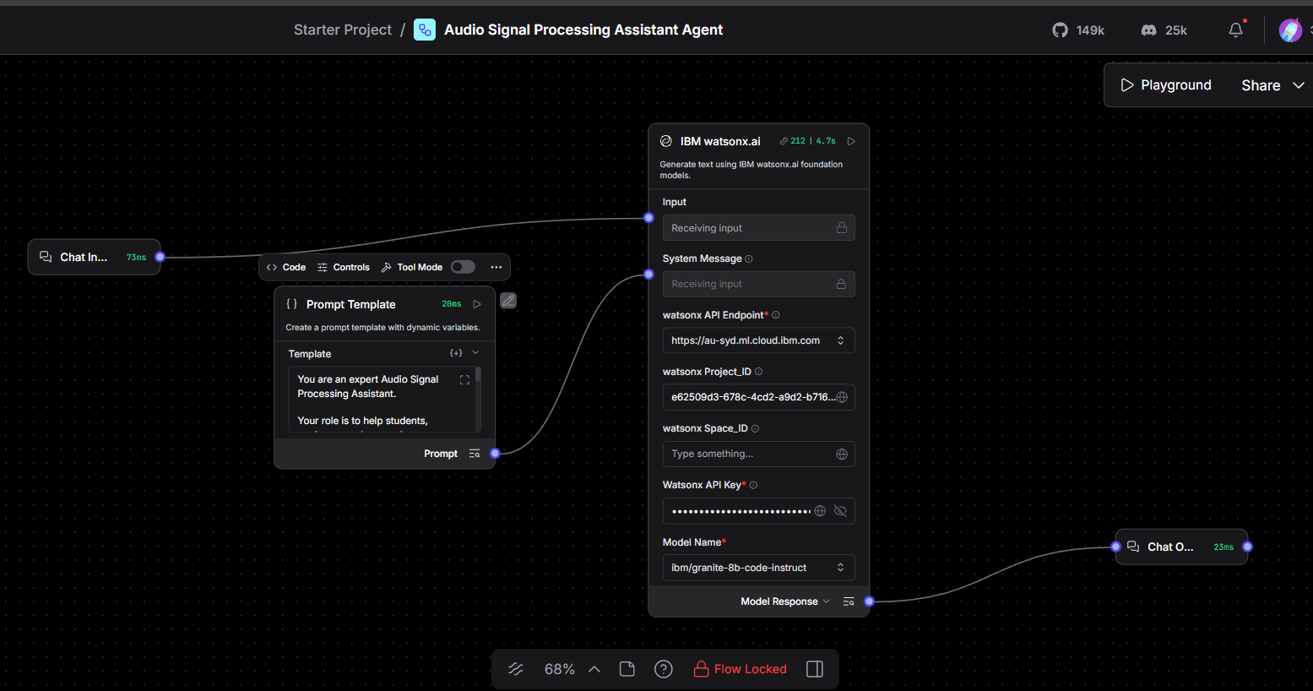
Langflow workflow -

Slide 7
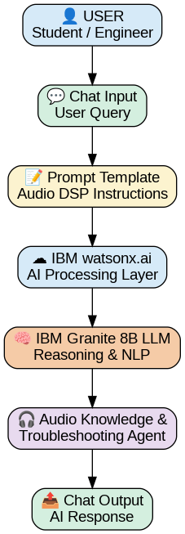
Architecture blueprint

Slide 8

Role of Agentic AI in the solution
Role of Agentic AI in the Audio Signal Processing Assistant Agent
Agentic AI enables the Audio Signal Processing Assistant Agent to function as an intelligent problem-solving system rather than a traditional chatbot. Using IBM Watsonx.ai and IBM Granite foundation models, the agent can understand user queries, reason about audio-related issues, and provide context-aware recommendations.
The system acts as a specialized AI assistant for audio signal processing by analyzing user questions related to noise reduction, signal distortion, filtering, sampling, quantization, frequency analysis, and audio equipment troubleshooting.
Benefits of Agentic AI in this Project
✅ Intelligent decision-making
✅ Context-aware responses
✅ Audio troubleshooting support
✅ Personalized technical guidance
✅ Faster access to DSP knowledge
✅ Enhanced learning experience

Slide 9
Novelty and Uniqueness
The proposed Audio Signal Processing Assistant Agent stands out by combining Agentic AI, Large Language Models (LLMs), and Audio Engineering Knowledge into a single intelligent assistance platform.
AI-Powered Audio Expert: Unlike traditional educational resources, the system provides instant, interactive, and context-aware guidance for audio signal processing concepts and troubleshooting.
Specialized Domain Knowledge: The assistant is specifically designed for audio signal processing applications, including filtering, sampling, quantization, noise reduction, distortion analysis, and audio equipment diagnostics.
Natural Language Interaction
Users can communicate with the system using simple natural language instead of searching through multiple technical documents or manuals.
Intelligent Troubleshooting: The agent can analyze user-reported audio issues and suggest possible causes, diagnostic steps, and corrective actions in real time.
Educational and Practical Support
The system serves both as a learning assistant for students and a technical support tool for engineers and audio enthusiasts.
Integration of IBM Granite Models
The project leverages IBM Granite foundation models through IBM watsonx.ai, enabling advanced reasoning, explanation generation, and technical guidance.
Low-Code AI Development: By utilizing LangFlow, the solution demonstrates how sophisticated AI assistants can be developed through visual workflow design without extensive coding.

Slide 10
Future Scope
1. Real-Time Audio File Analysis
Future versions can allow users to upload audio files for automatic analysis of noise, distortion, clipping, frequency response, and signal quality issues.
2. Audio Spectrum Visualization
The system can be enhanced with waveform and spectrum analysis tools to provide graphical representations of audio signals using FFT and frequency-domain techniques.
3. Voice-Based Interaction
Integration of Speech-to-Text and Text-to-Speech technologies will enable users to interact with the assistant through voice commands and receive spoken responses.
4. Advanced DSP Design Assistance
The assistant can be extended to provide filter design recommendations, equalizer settings, signal conditioning techniques, and DSP algorithm guidance for engineering applications.
5. Integration with IoT Audio Devices
The system can be connected with microphones, speakers, smart audio systems, and IoT devices for real-time monitoring and diagnostics.
·
·
·

Slide 11


